Slide 1

THE GURKHAS
Department of Electronics and Computer Engineering
Institute of Engineering, Thapathali Campus
For EX 554 Computer Graphics Project
Presented by: Presentation Date:
075/BEI/006 Anjal Bam 10th December, 2020
075/BEI/011 Bishwa Prakash Subedi
075/BEI/012 Bishwash Gurung
075/BEI/032 Rewan Gautam

Slide 2
INTRODUCTION
The Gurkhas, 2D arcade game
Creative game inspired by border disputes
Programmed in Python
Graphics library used :- PyGame

Slide 3
OBJECTIVES
Apply theoretical knowledge to something practical
Show creativity and develop a game
Brain storming game logic and working on problem-solving skills
Use of various libraries, and practising coding in python
Understanding the use of graphics in development of games and other fields as well
Learn to work as a team
Get hands-on and practice with various modern development tools such as git/GitHub, VSCode, Python, etc.
Understand the actual development process of a piece of a software.

Slide 4
SCOPE
Players of any age can have enjoyable experience.
Youngsters can get alert of the border disputes.
Love, devotion, and sense of attachment to the country
Helps to test the strategic skills of the players

Slide 5
ALGORITHMS
For player movement:
1. Start
2. Initialize x and y axis on the screen for the player
3. Check for pressed keys through pygame
3.1 If key = left
Decrease player's x axis position
3.2 Else if key = right
Increase player's x axis position
3.3 Else if key = up
Decrease player's y axis position
3.4 Else if key = down
Increase player's y axis position
[End of if]
4. Stop

Slide 6
Contd…
Killing enemy:
1. Start
2. Read player's current position x, y
3. Initialize a kill range value k
4. Check for each enemy from list of enemies
4.1 If (x+k) > x axis of enemy > (x-k) and (y+k) > y axis of enemy > (y-k)
Remove enemy from the list
Increase score by 1
Decrease enemy count by 1
[End of if]
5. Play killing sound through pygame
6. Stop

Slide 7
Contd…
Creating random enemies:
1. Start
2. Initialize x and y axis range to create enemies
3. Random function from python's random package for generating random value random_y between a certain range
4. if enemy count < 5
Append the random value to the enemies list
Increase enemy count by 1
5. Stop

Slide 8
Contd…
Carrying border pillar:
1. Start
2. Initialize pillar position x, y
2. Initialize a closeness 'c' of pillar value
3. Check for each enemy from list of enemies
3.1 if (x+c) > x axis of enemy > (x-c) and (y+c) > y axis of enemy > (y-c)
x = x axis of enemy
y = y axis of enemy
[End of if]
4. Stop

Slide 9
Contd…
Enemy crossing the border score:
1. Start
2. Check for each enemy from list of enemies
2.1 if x axis of enemy < 0
Decrease score by 1
Remove the enemy from enemy list
Decrease the enemy count by 1
[End of if]
3. Stop

Slide 10
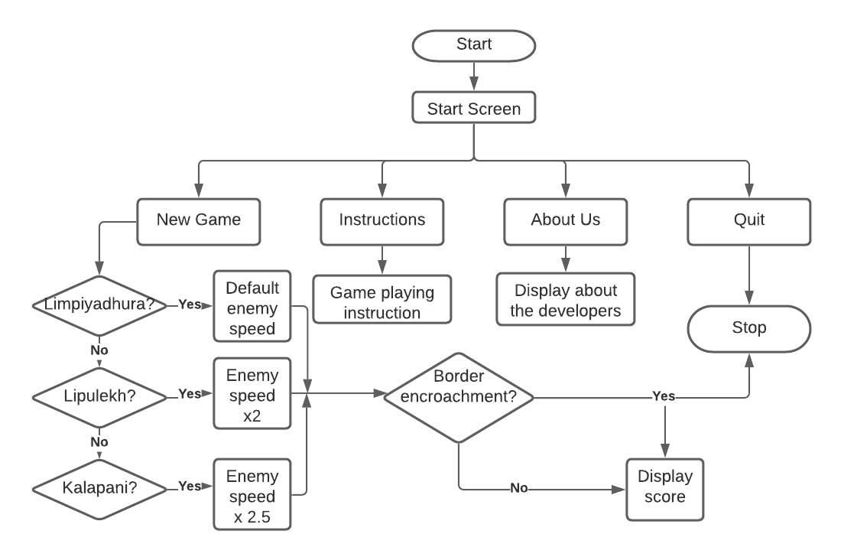
FLOWCHART

Slide 11
WORKING PRINCIPLE
When we the run the file, menu will be shown with music being played
The menu are manually set up with fixed co-ordinates
Hovering the menu changes its color
The pygame library allows us to find the x and y co-ordinates of the current mouse pointer
Clicking 'New game' option, we get sub-menu ‘Limpiyadhura', ‘Lipulekh' and ‘Kalapani' which was also setup manually

Slide 12
Contd…
Clicking anyone of these starts our game loop
Arrow keys from keyboard is read by pygame, which helps to change the x and y co-ordinates of the players
Enemies are randomly generated at first and after each border cross
Enemies x axis positions are always decreased
If border pillar is near any enemy, the border pillar gets its co-ordinate and moves with the enemy unless the enemy is killed

Slide 13
Contd...
Player can kill the enemy with 'space bar' if it is near it's x and y axis
Score is increased and decreased if enemy is killed and crosses border respectively
If border pillar reaches the left-most side of the screen, "gameover another border encroachment" is displayed, and sound is played

Slide 14
ISSUES FACED
Have to setup menu manually based on co-ordinates
Forced to use many global variables
Cannot resize the game window
When adding text, line breaks are not supported
Game sounds playing in loop resulting to echo

Slide 15
FURTHER WORKS
Work on its animations
Transition from 2D to 3D
Develop new maps
Store high scores
Make the game window responsive
Add more features like global leader board functionality
Develop its Android and Apple versions

Slide 16
CONCLUSION
A fun and challenging experience
Simple but creative
A glimmer of what’s possible

Slide 17
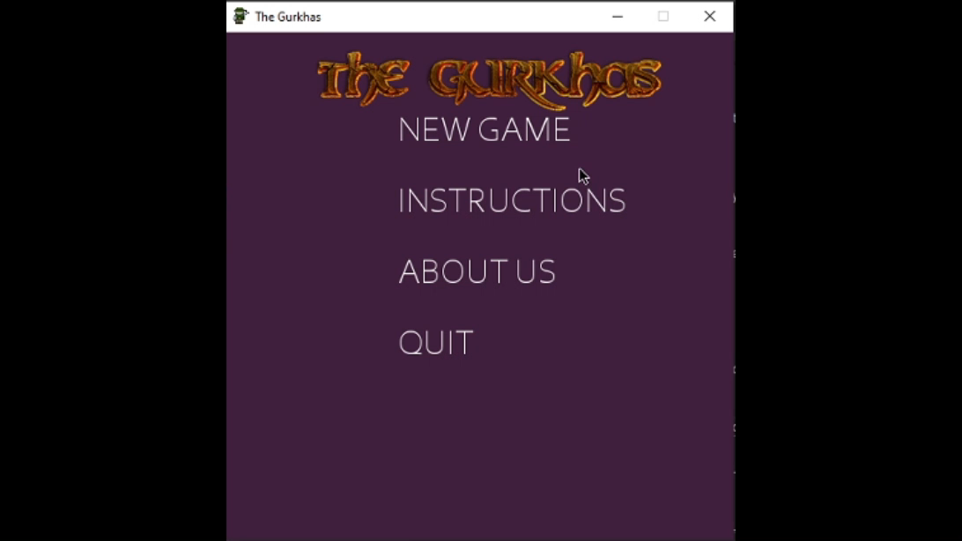
DEMO

Slide 18
REFERENCES
Pygame.org. 2020. Pygame Front Page — Pygame V2.0.1.Dev1 Documentation. [online] Available at: <https://www.pygame.org/docs/> [Accessed 9 December 2020].
Storyblocks.com. 2020. Knife Scrape Blade. [online] Available at: <https://www.storyblocks.com/audio/stock/knife-scrape-blade-seqeeba2ipsk0wxxjzu.html> [Accessed 9 December 2020].
Cooltext.com. 2020. Cool Text Graphics Generator. [online] Available at: < https://cooltext.com/Edit-Logo?LogoId=3704682269 > [Accessed 9 December 2020].
GeeksforGeeks. 2020. Creating Start Menu In Pygame - Geeksforgeeks. [online] Available at: https://www.geeksforgeeks.org/creating-start-menu-in-pygame/ [Accessed 9 December 2020].

Slide 19
Contd…
Unsplash.com. 2020. Photo By Johannes Plenio On Unsplash. [online] Available at: <https://unsplash.com/photos/oQ4DZpIIxHM/> [Accessed 9 December 2020].
Figma. 2020. Figma: The Collaborative Interface Design Tool.. [online] Available at: <https://www.figma.com/> [Accessed 9 December 2020].

